Slide 1

Node-RED

Slide 2
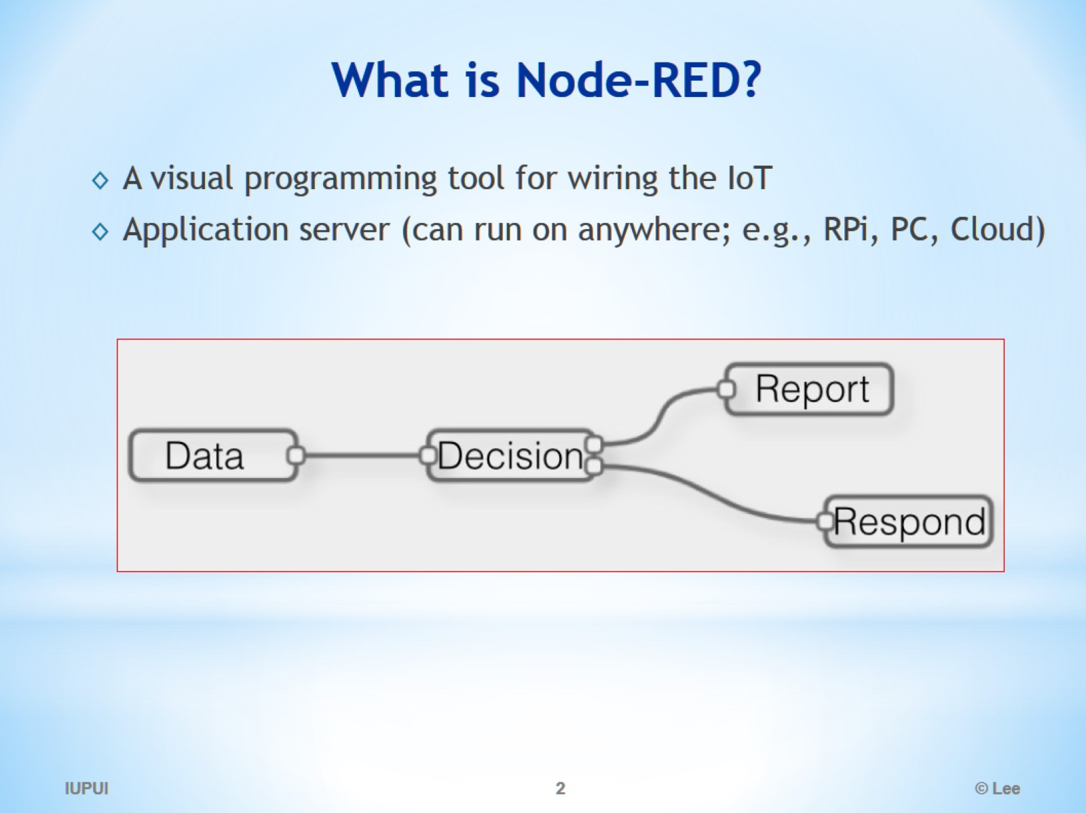
What is Node-RED?

Slide 3
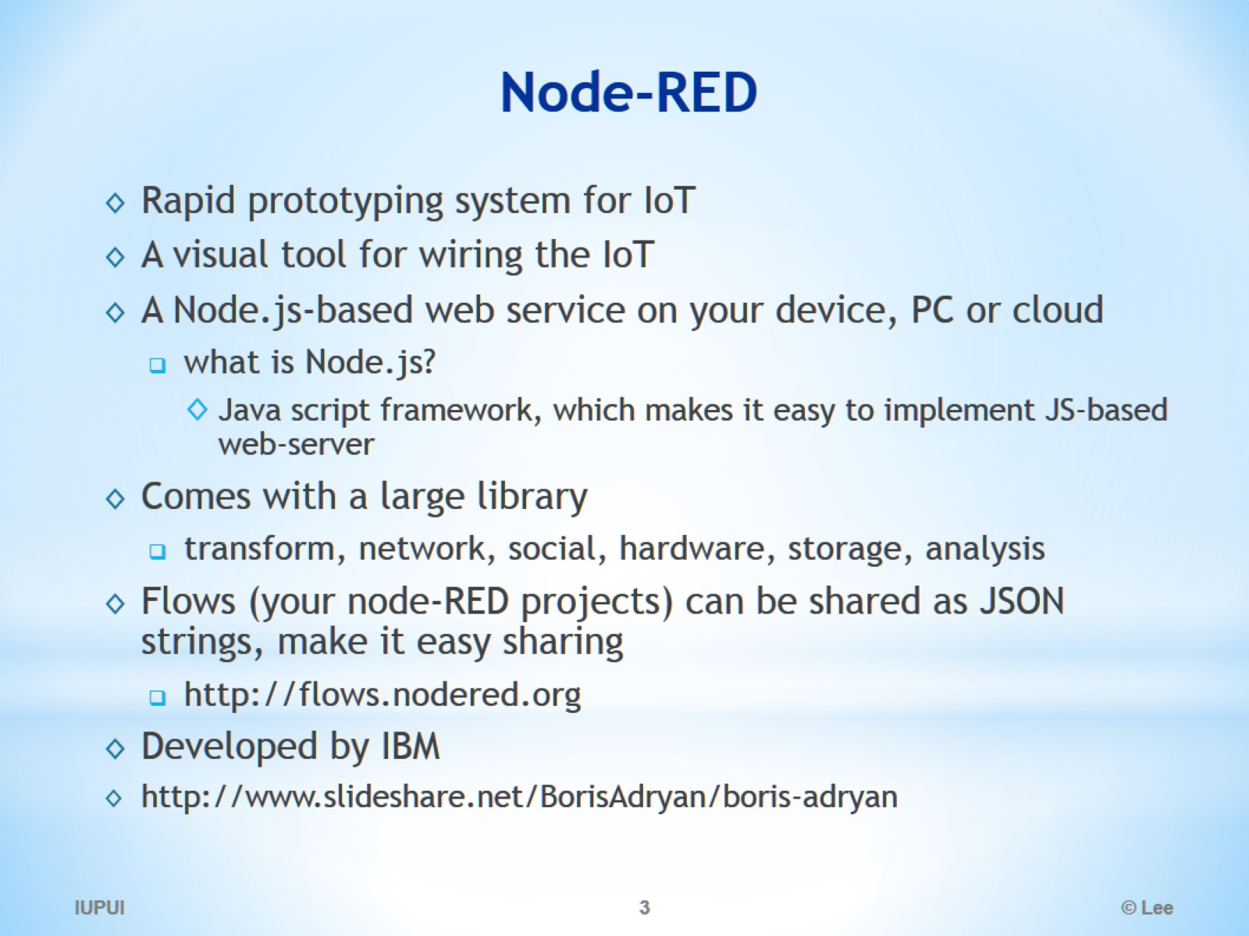
Node-RED

Slide 4
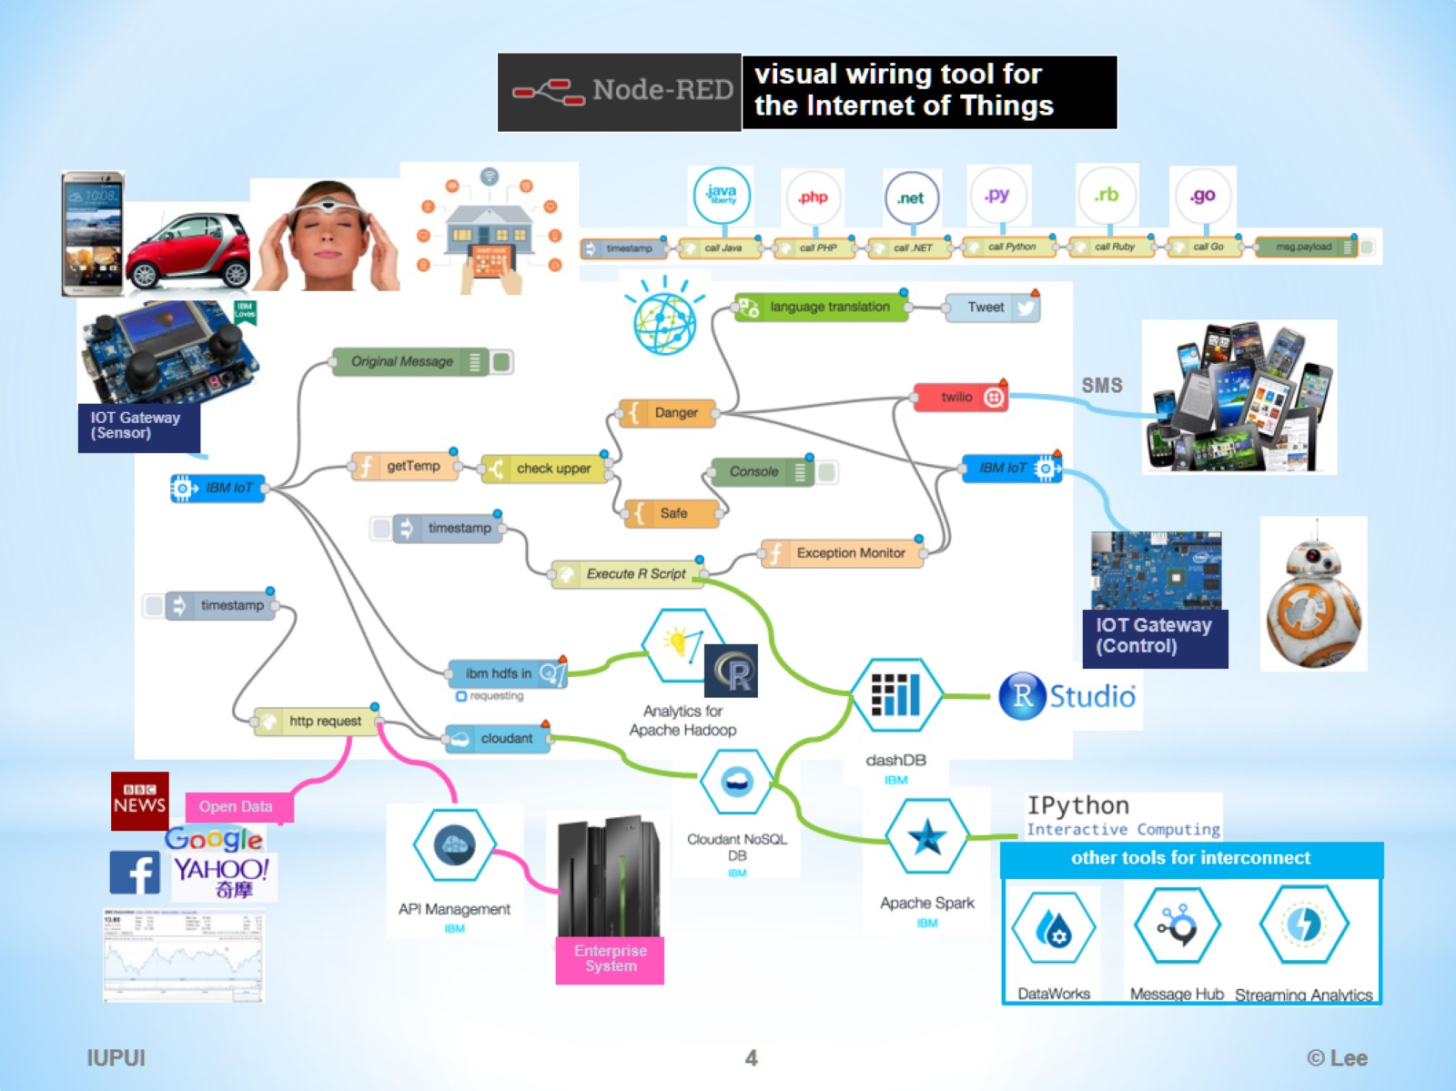

Slide 5
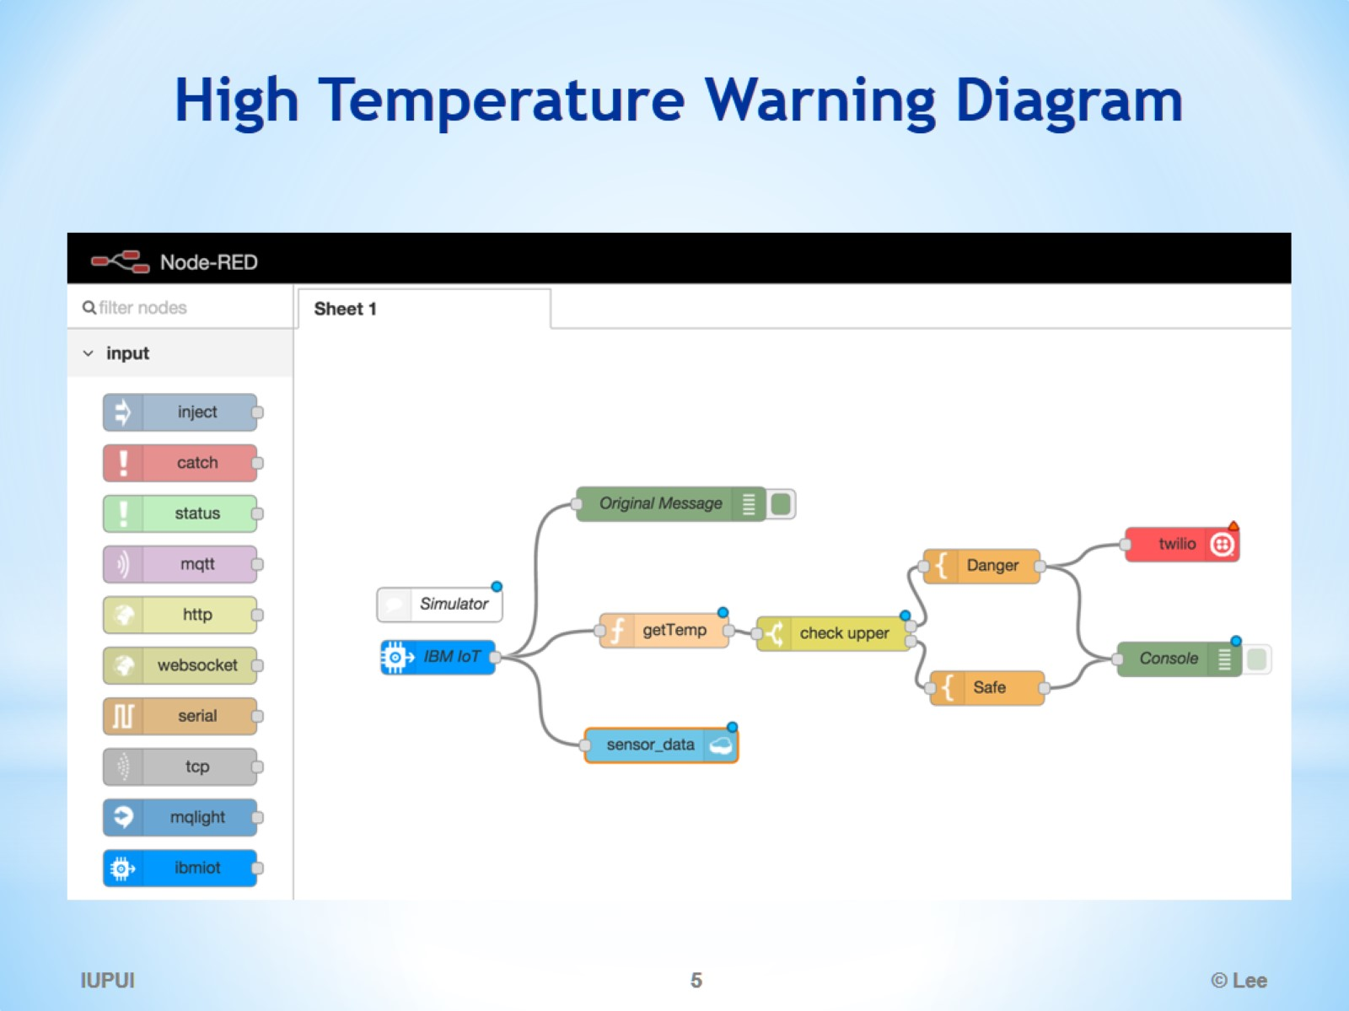
High Temperature Warning Diagram

Slide 6
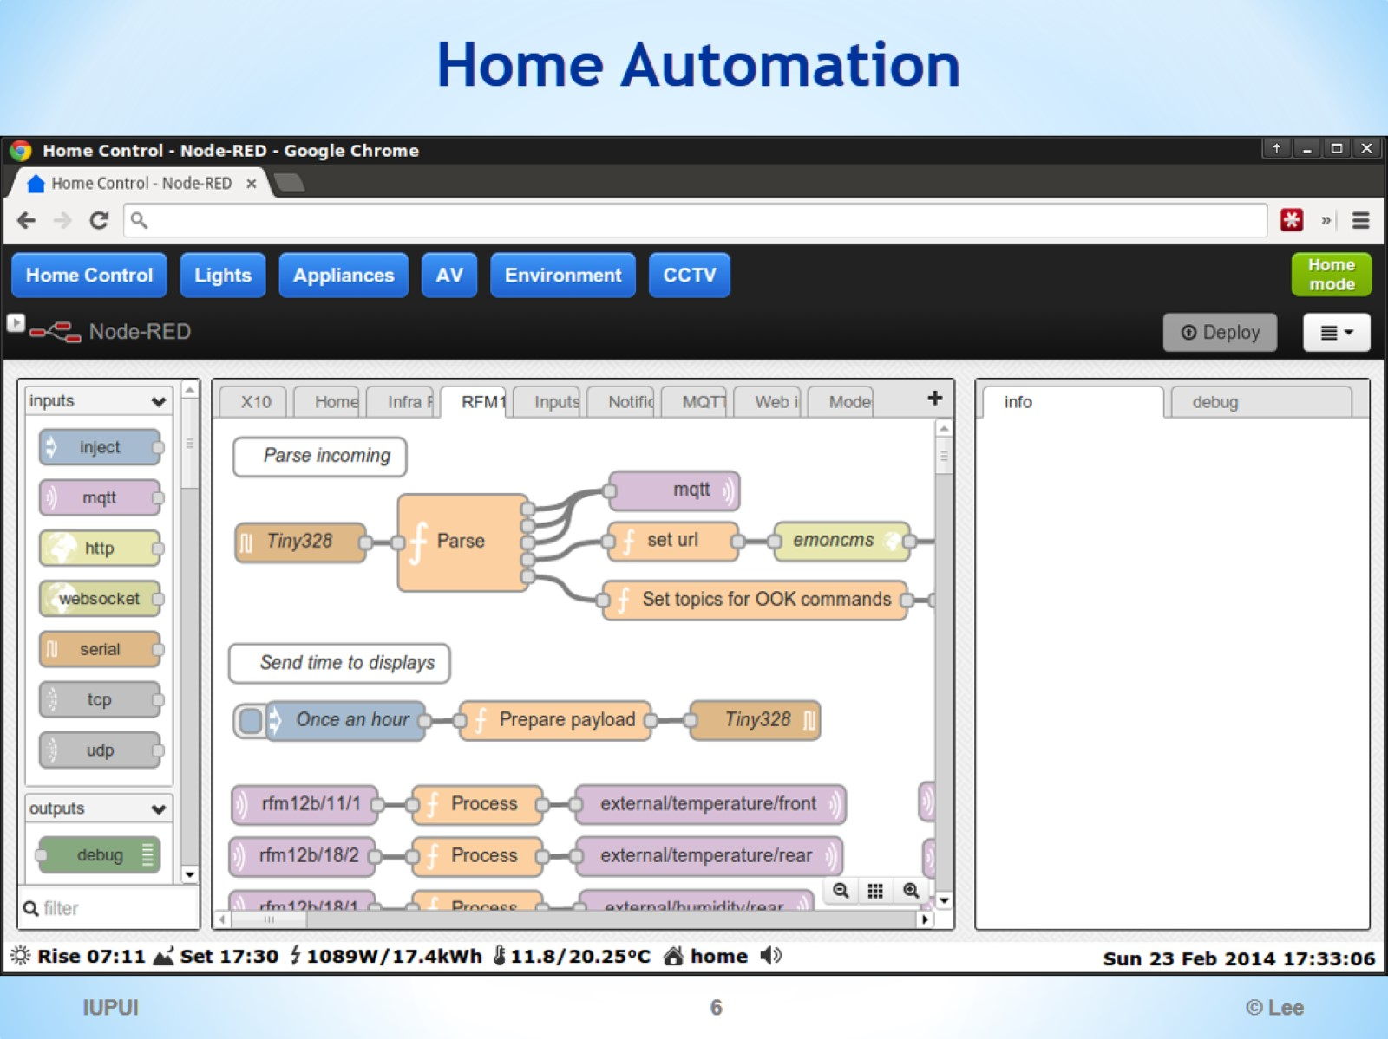
Home Automation

Slide 7
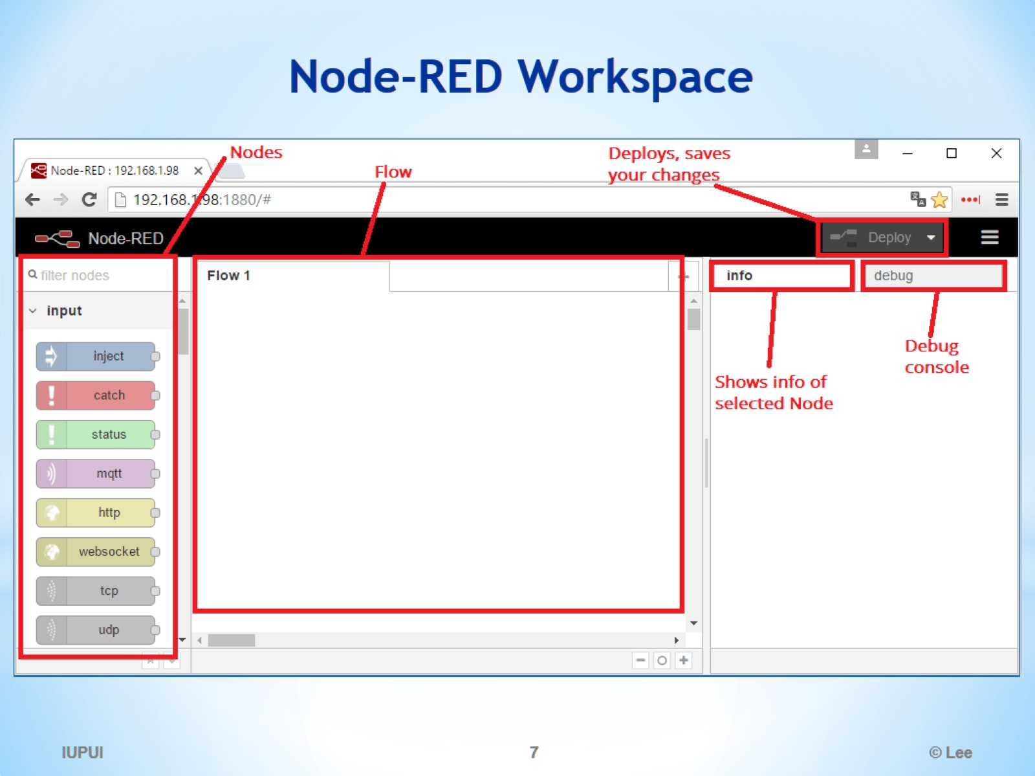
Node-RED Workspace

Slide 8
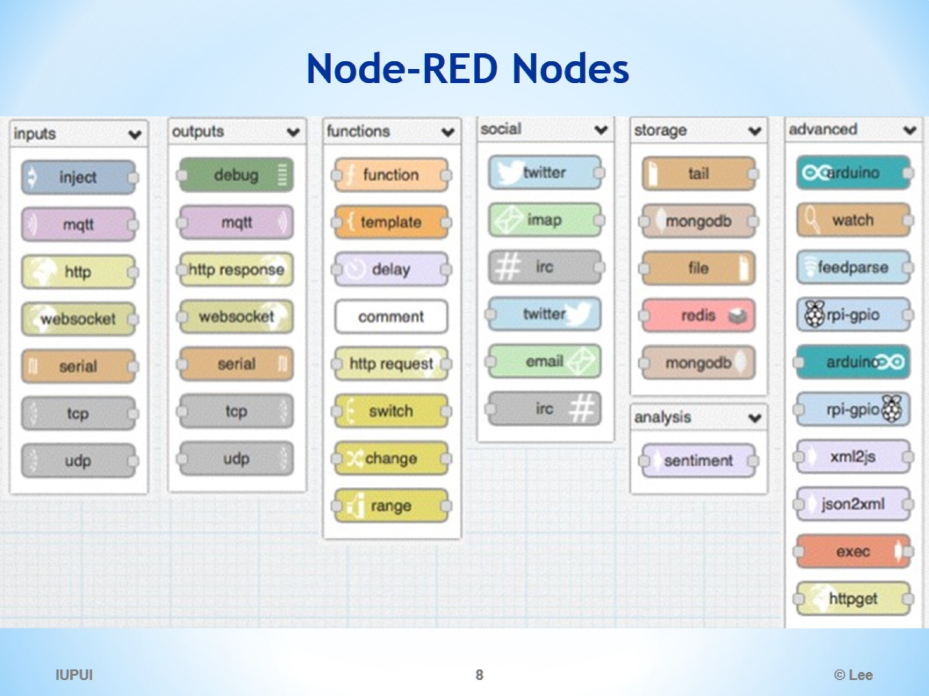
Node-RED Nodes

Slide 9
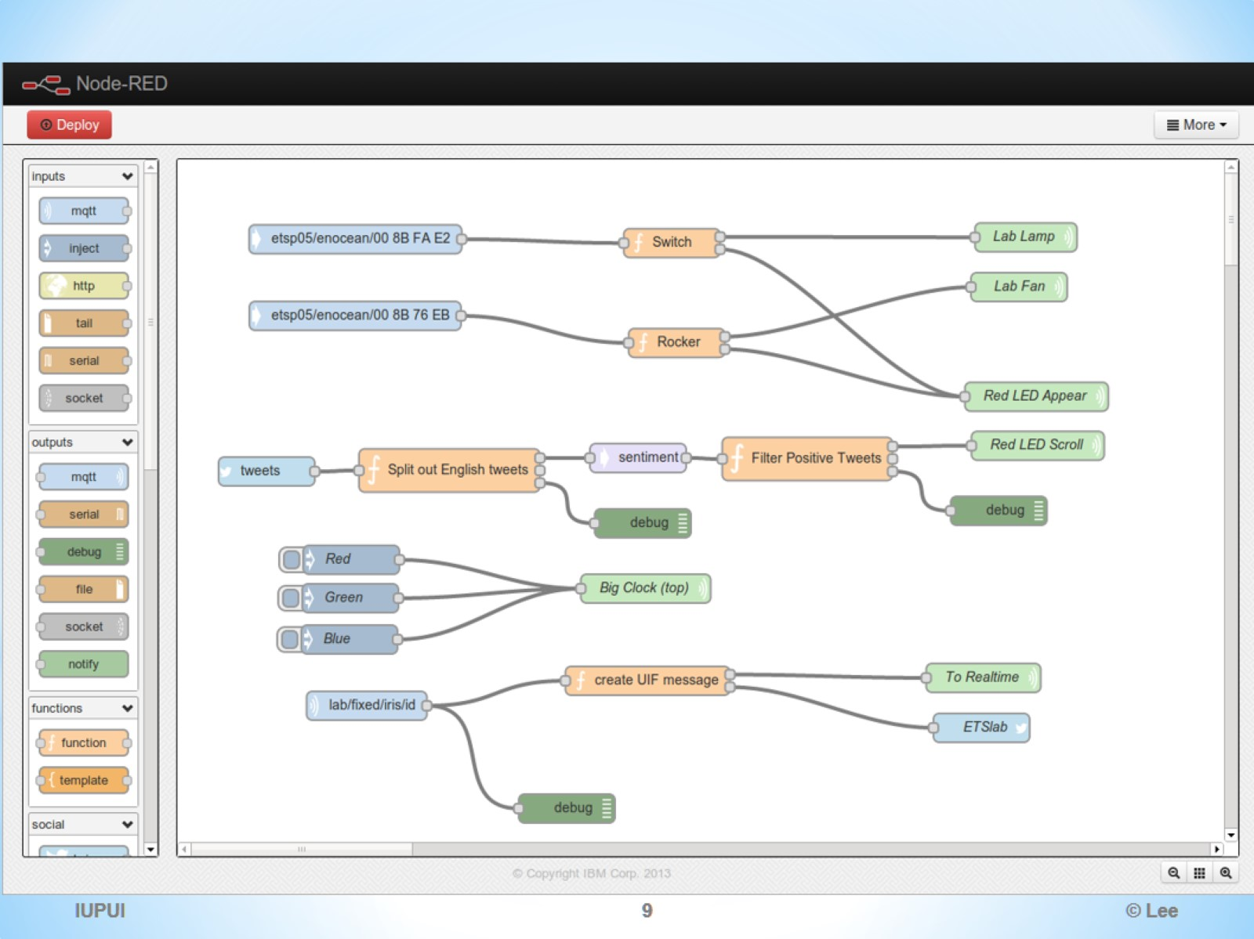

Slide 10
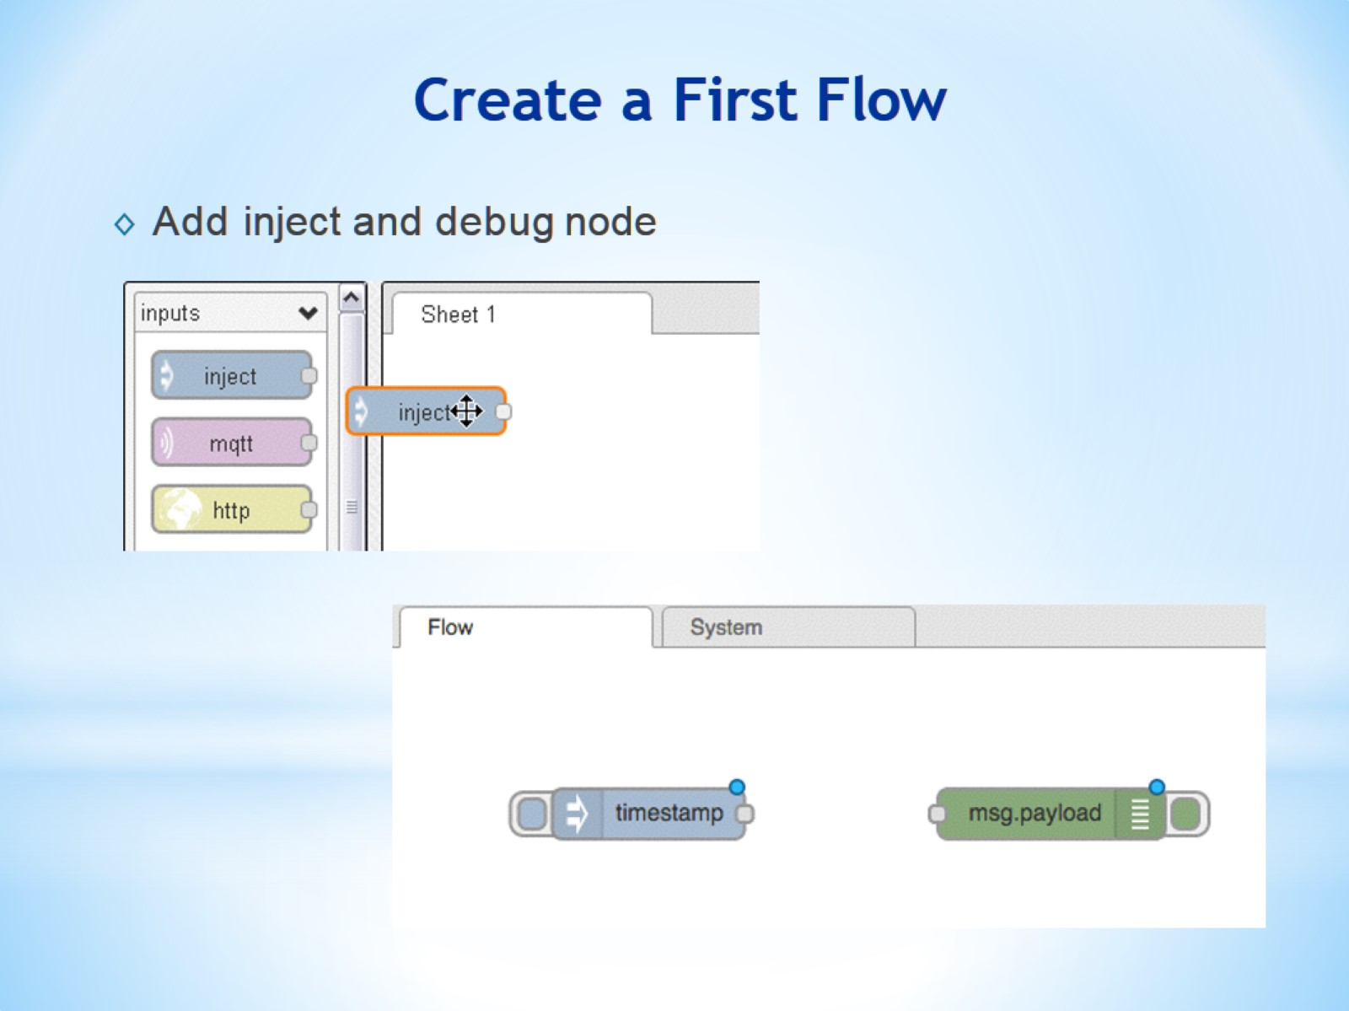
Create a First Flow

Slide 11
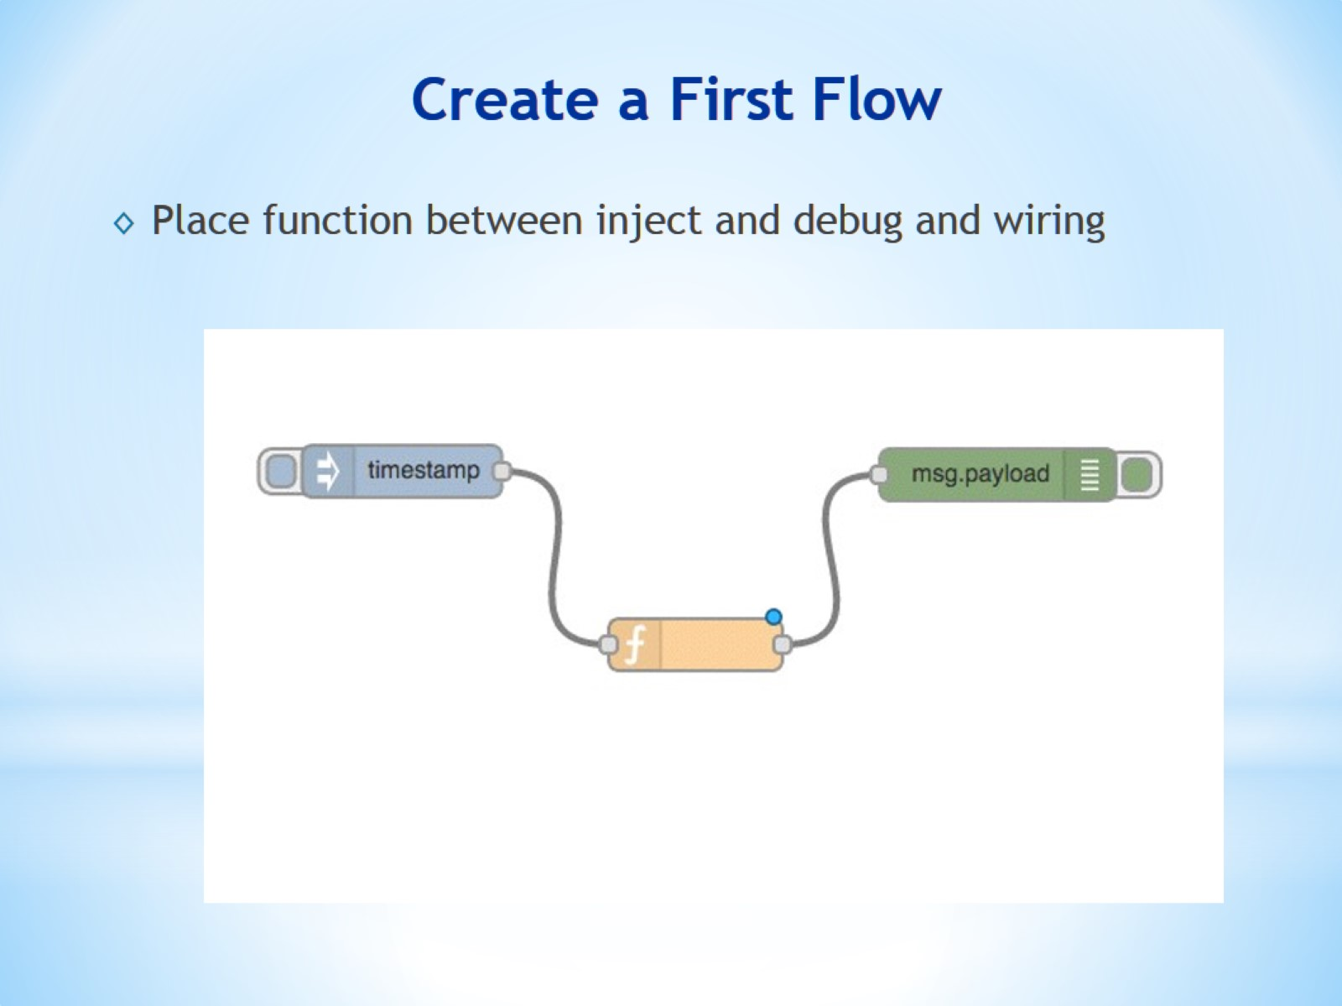
Create a First Flow

Slide 12
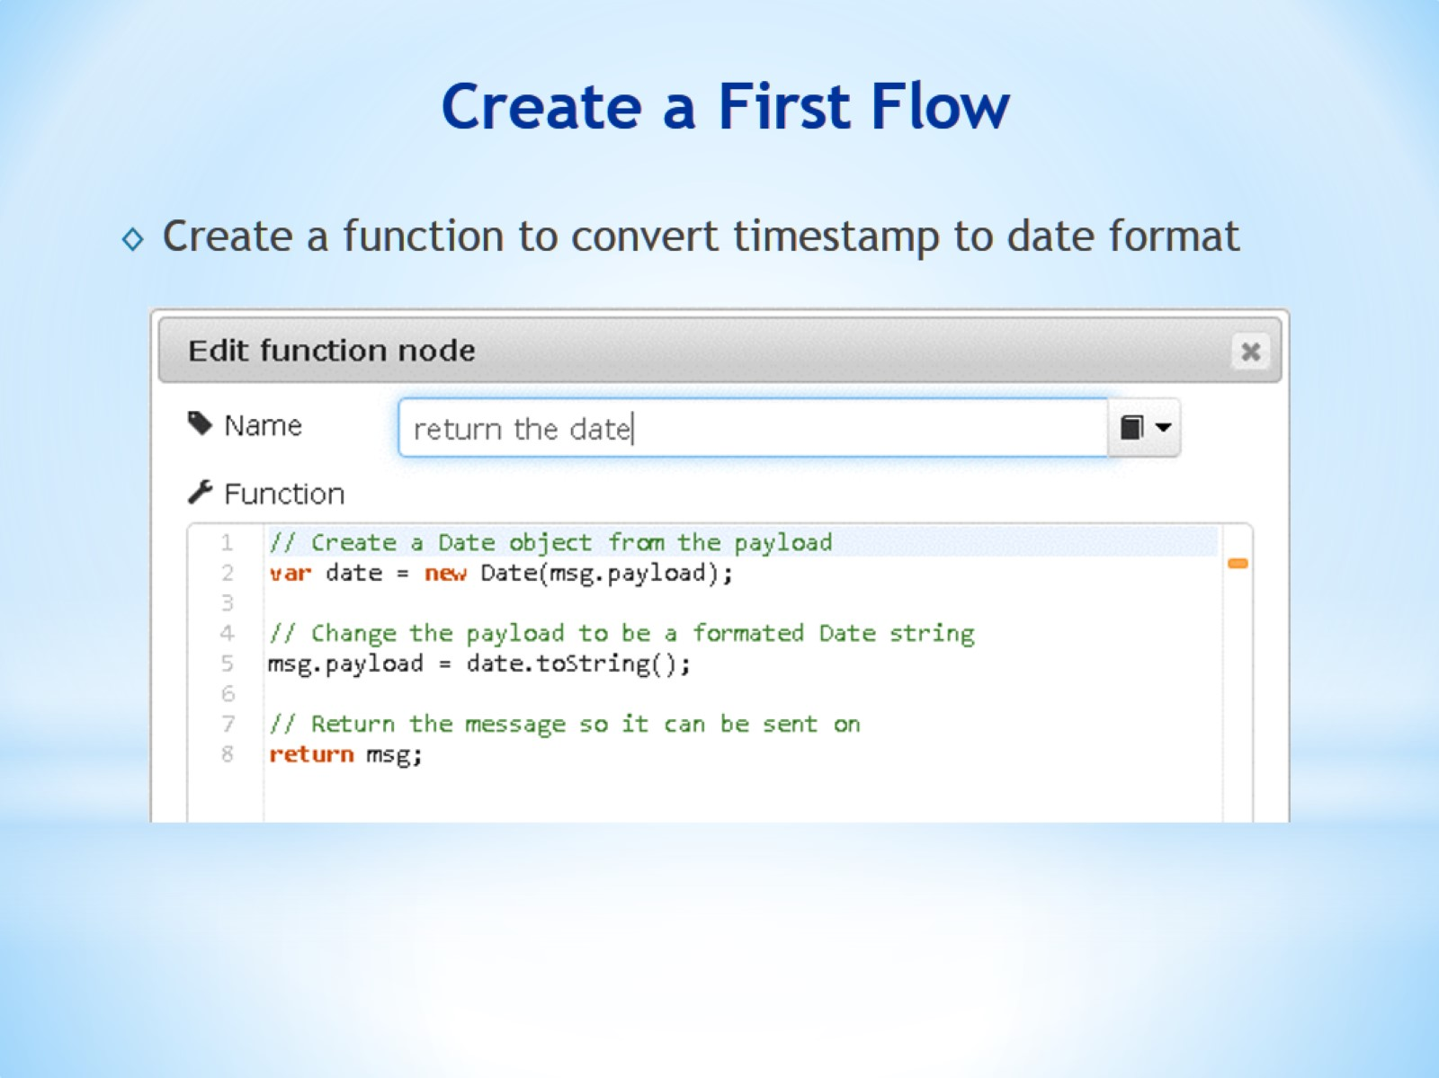
Create a First Flow

Slide 13
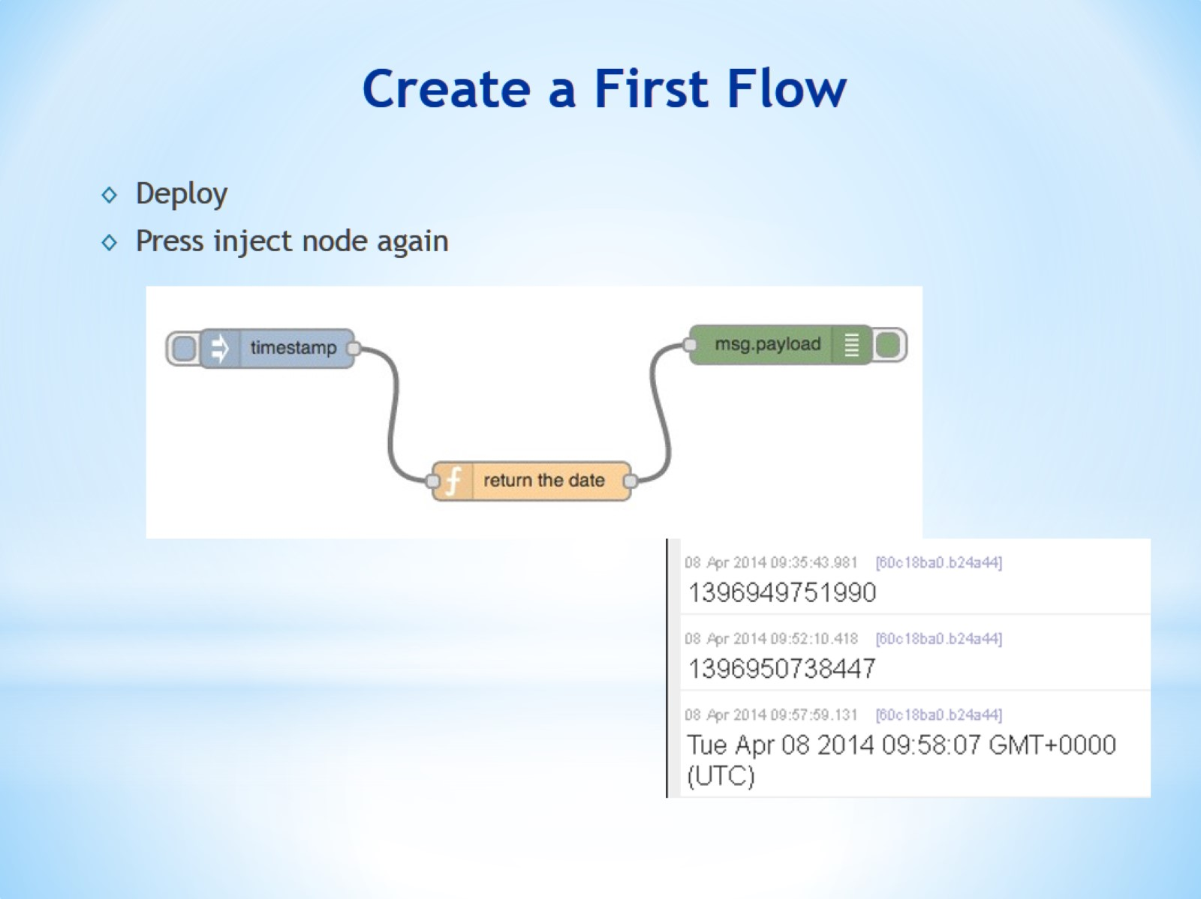
Create a First Flow

Slide 14
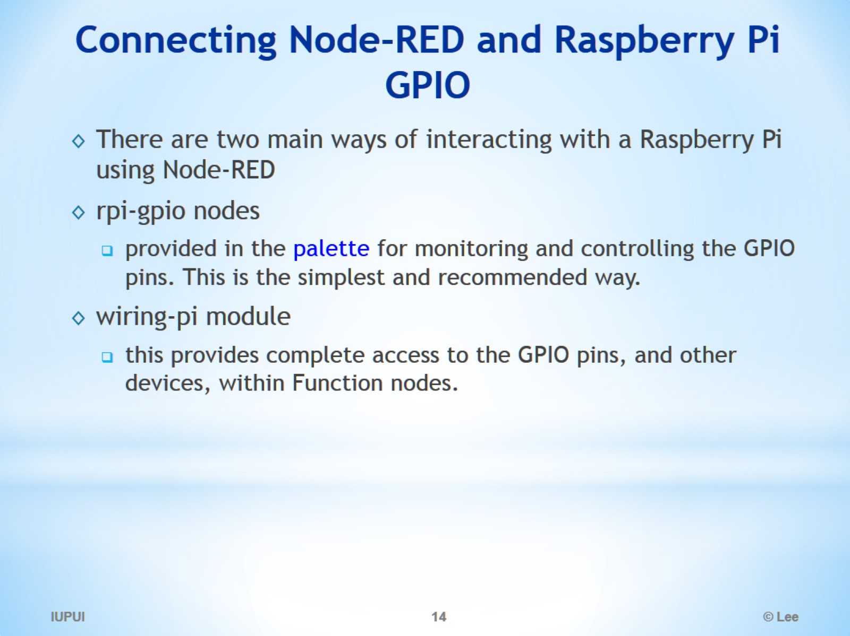
Connecting Node-RED and Raspberry Pi GPIO

Slide 15
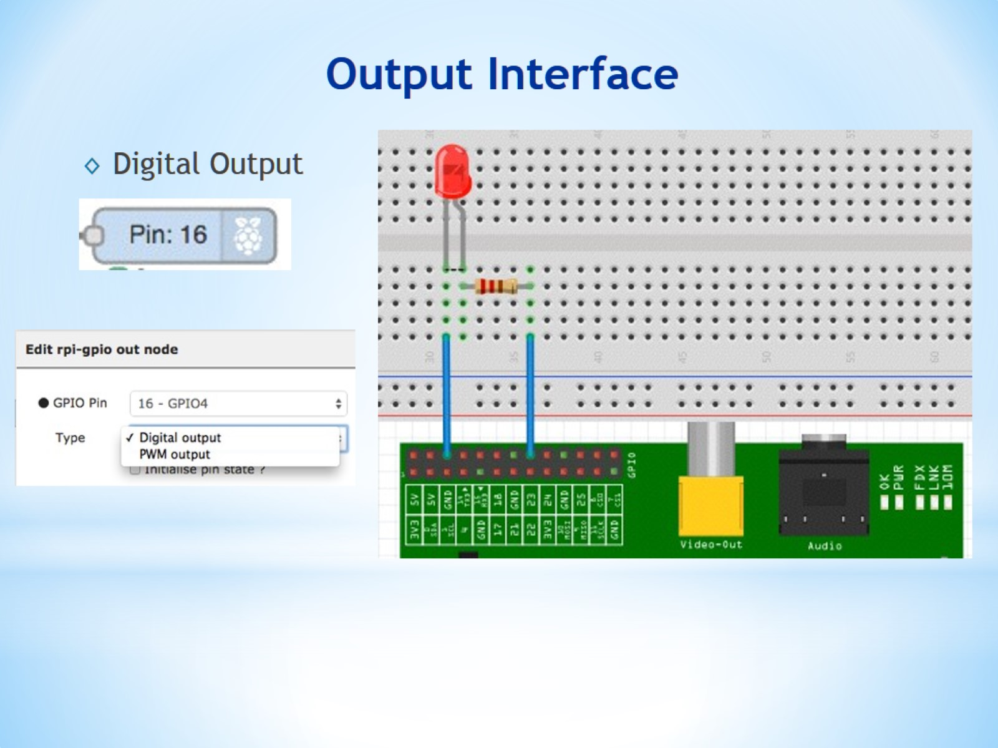
Output Interface

Slide 16
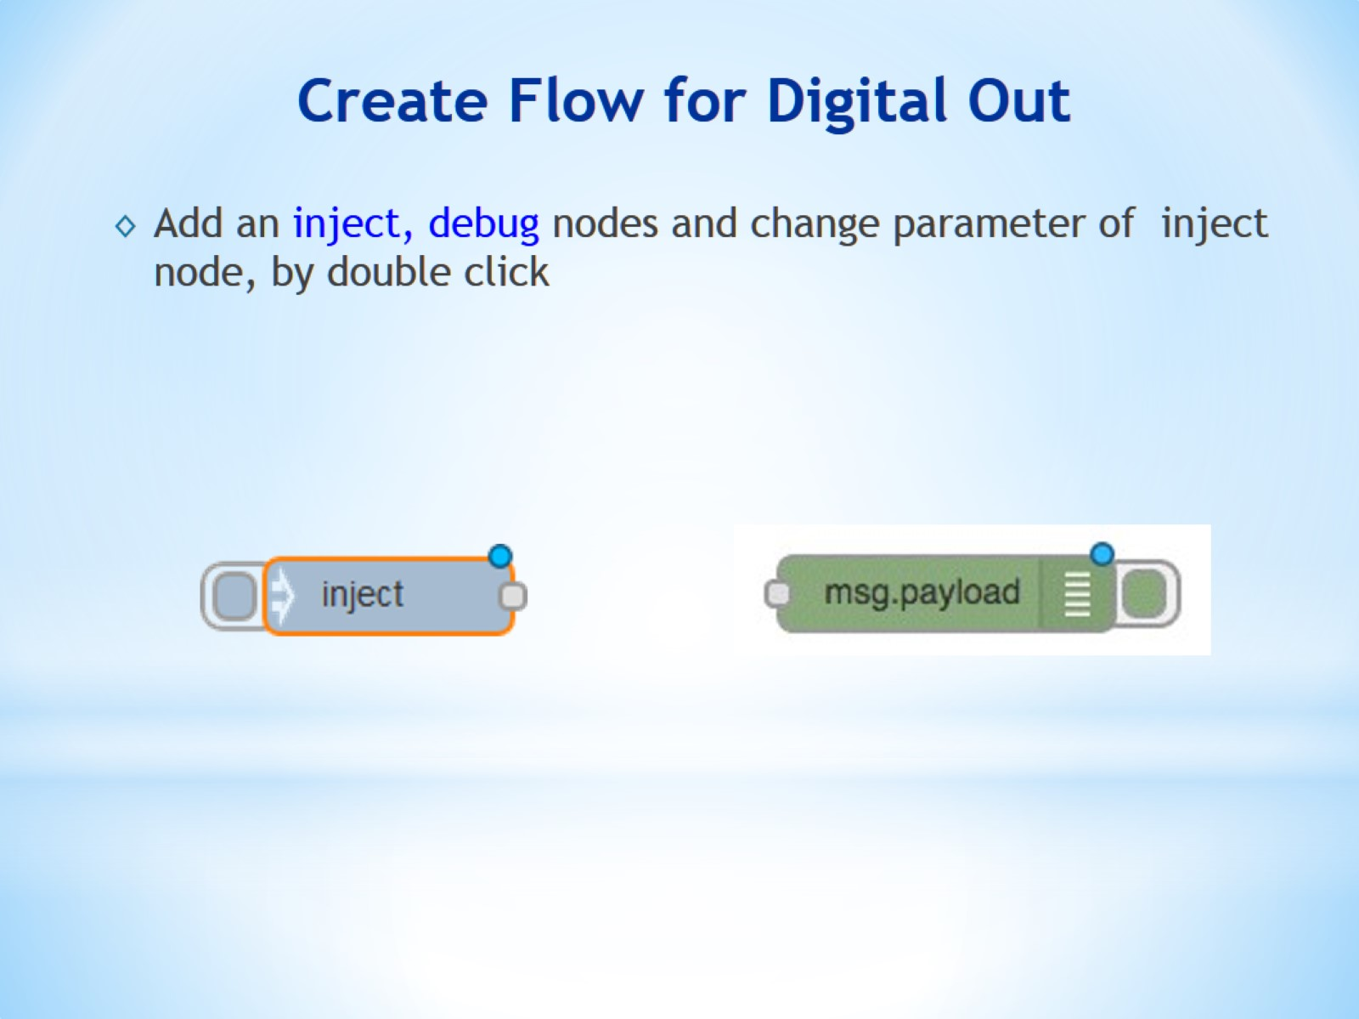
Create Flow for Digital Out

Slide 17
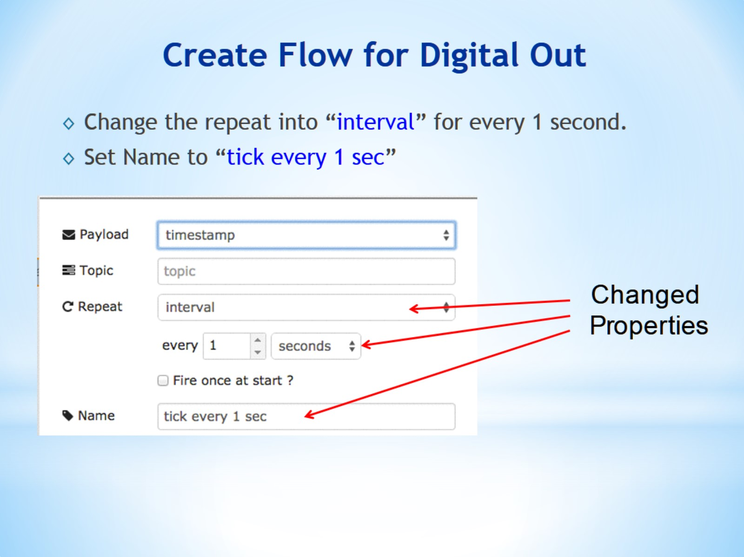
Create Flow for Digital Out

Slide 18
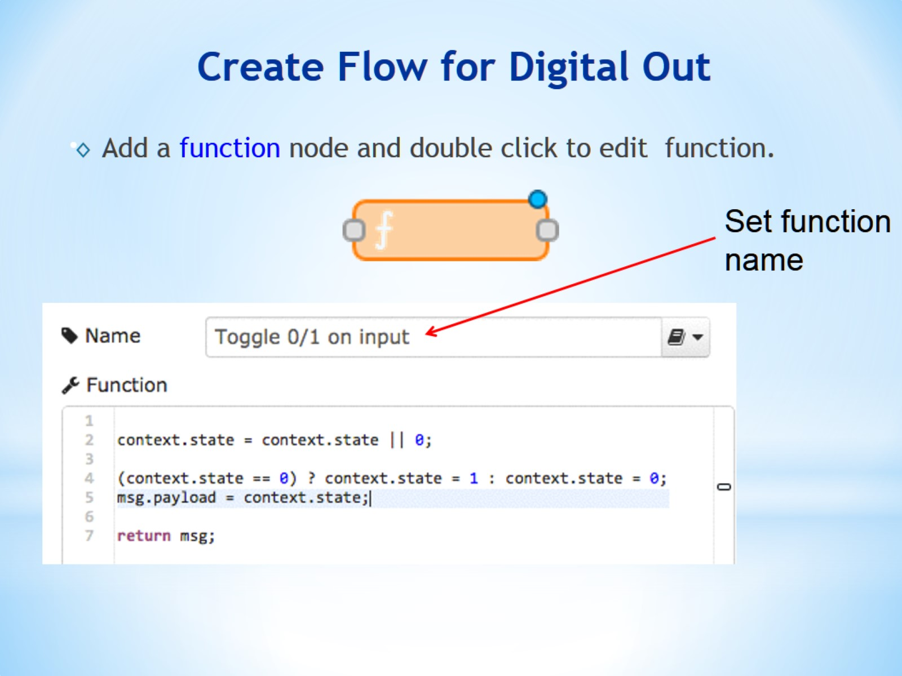
Create Flow for Digital Out

Slide 19
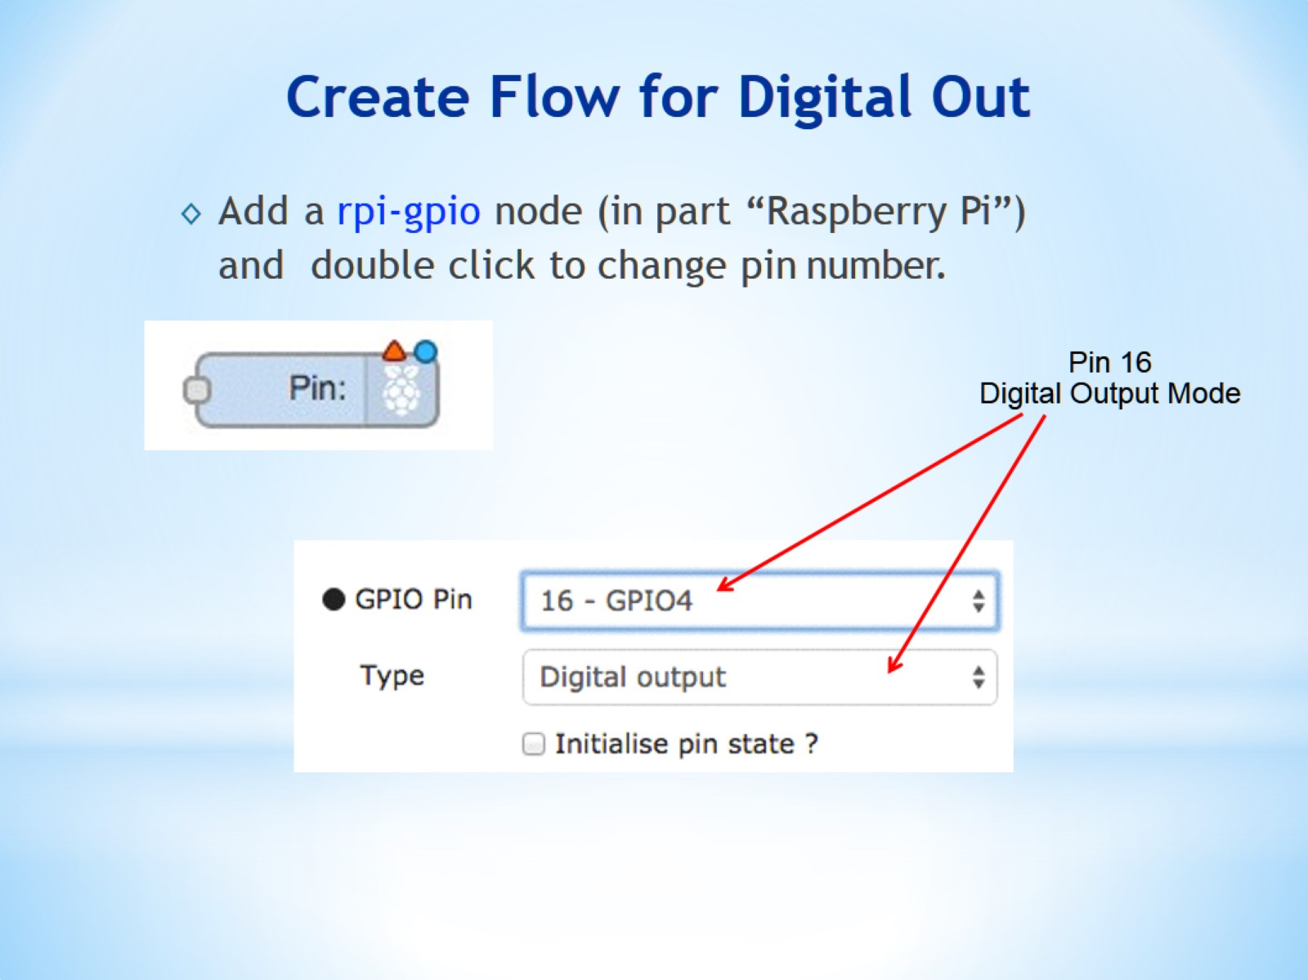
Create Flow for Digital Out

Slide 20
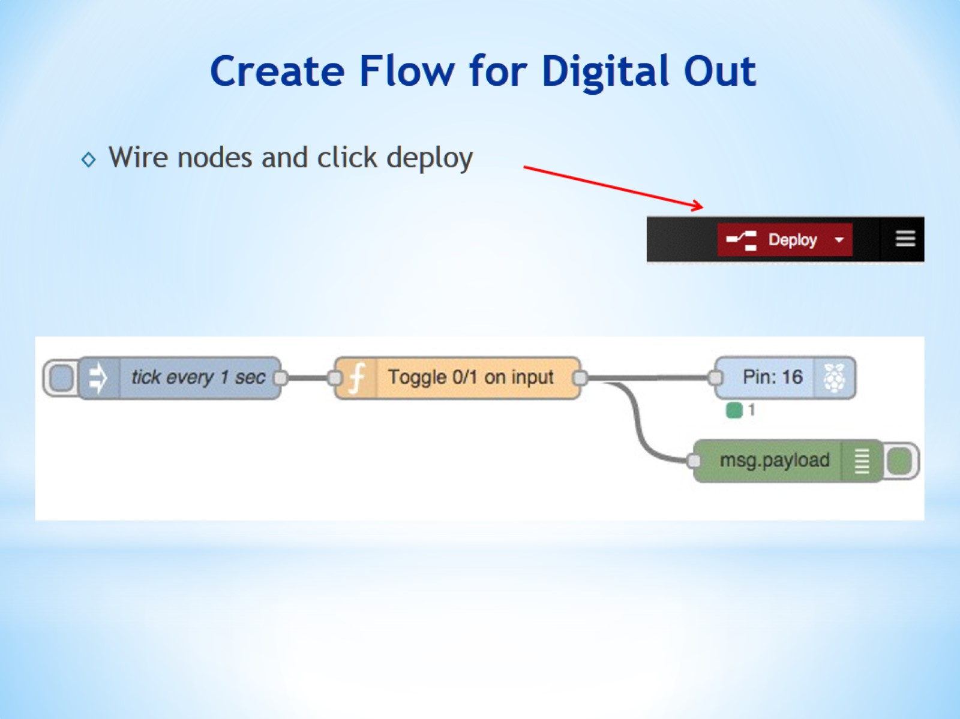
Create Flow for Digital Out

Slide 21
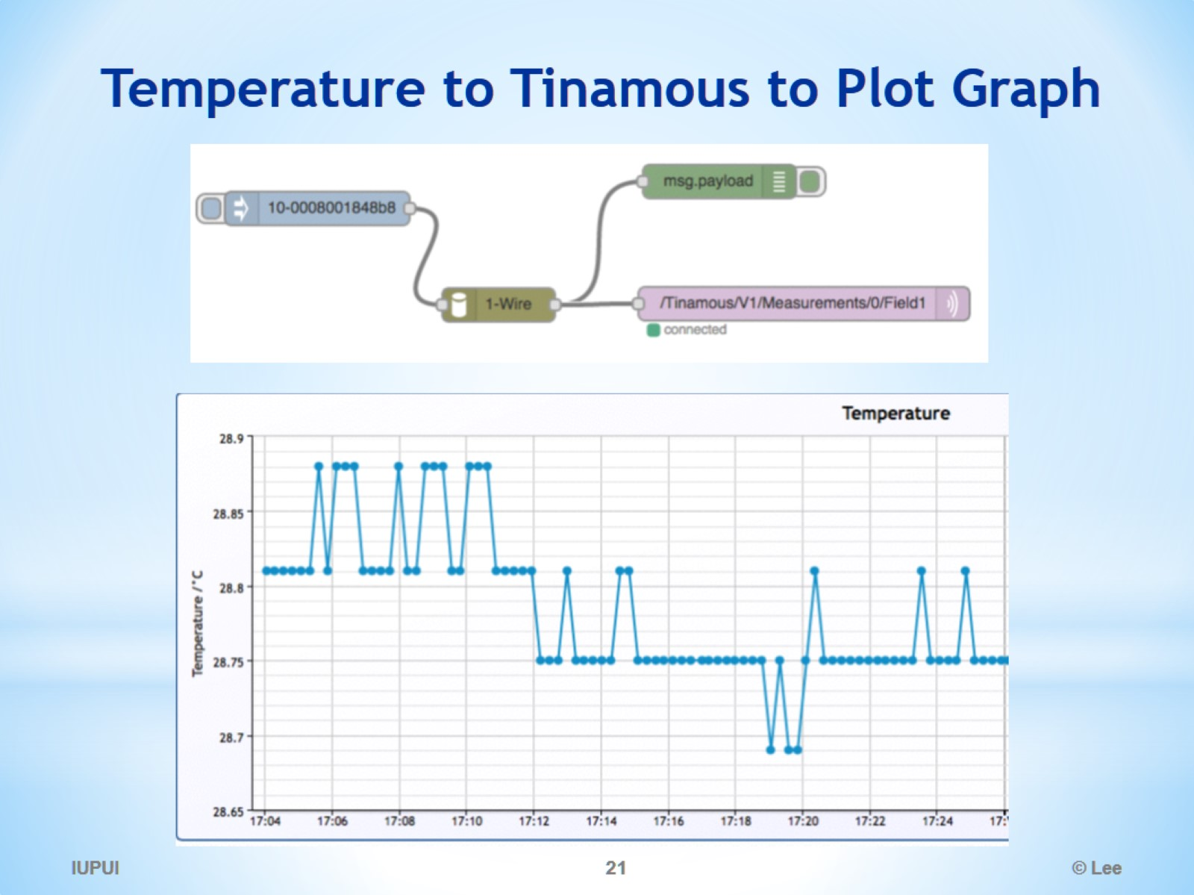
Temperature to Tinamous to Plot Graph

Slide 22
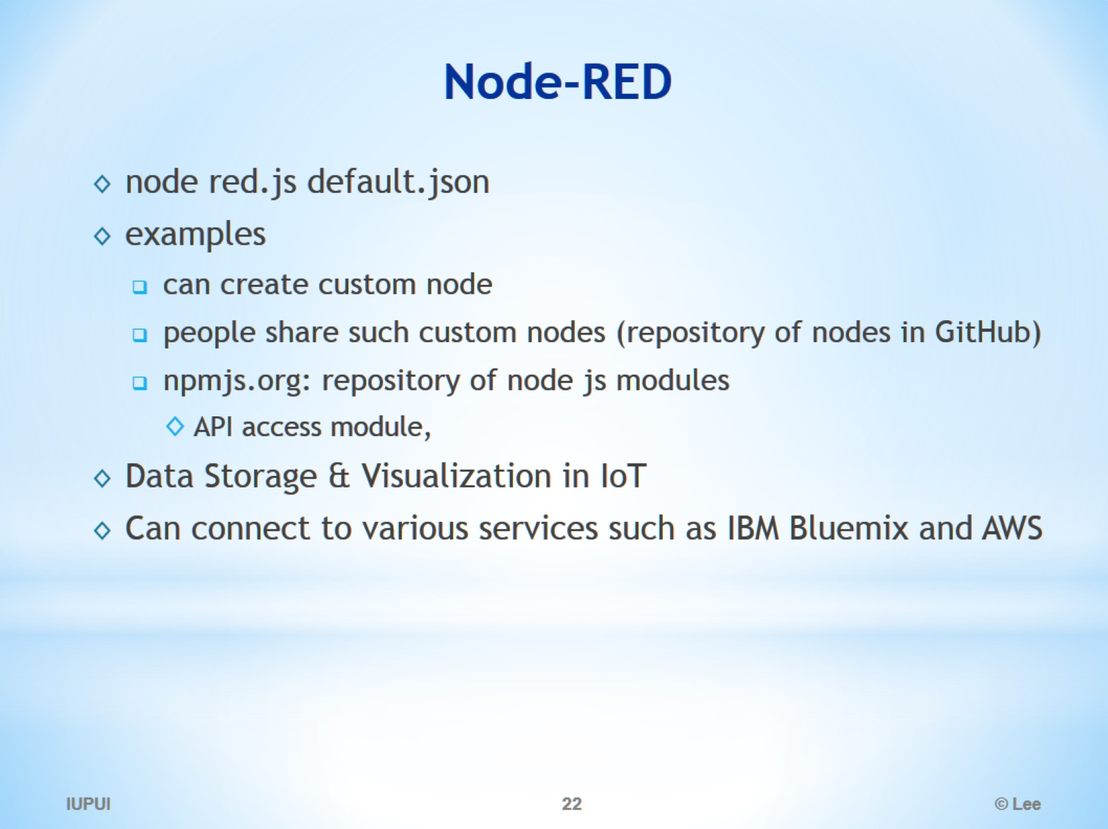
Node-RED

Slide 23
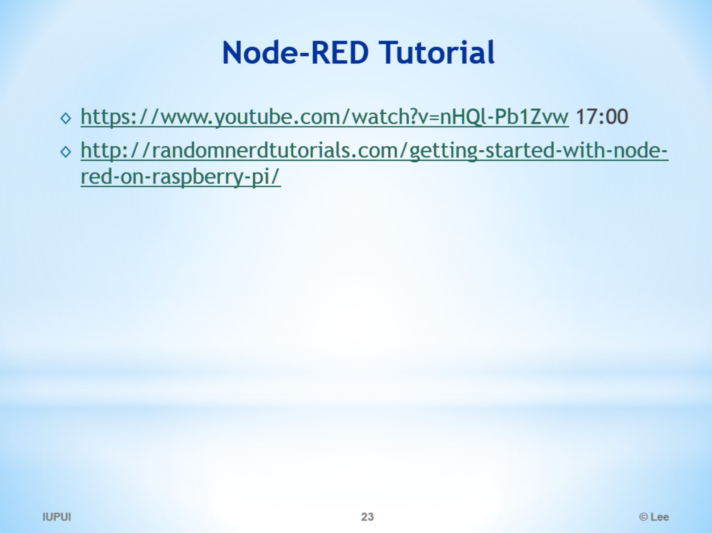
Node-RED Tutorial

Slide 24
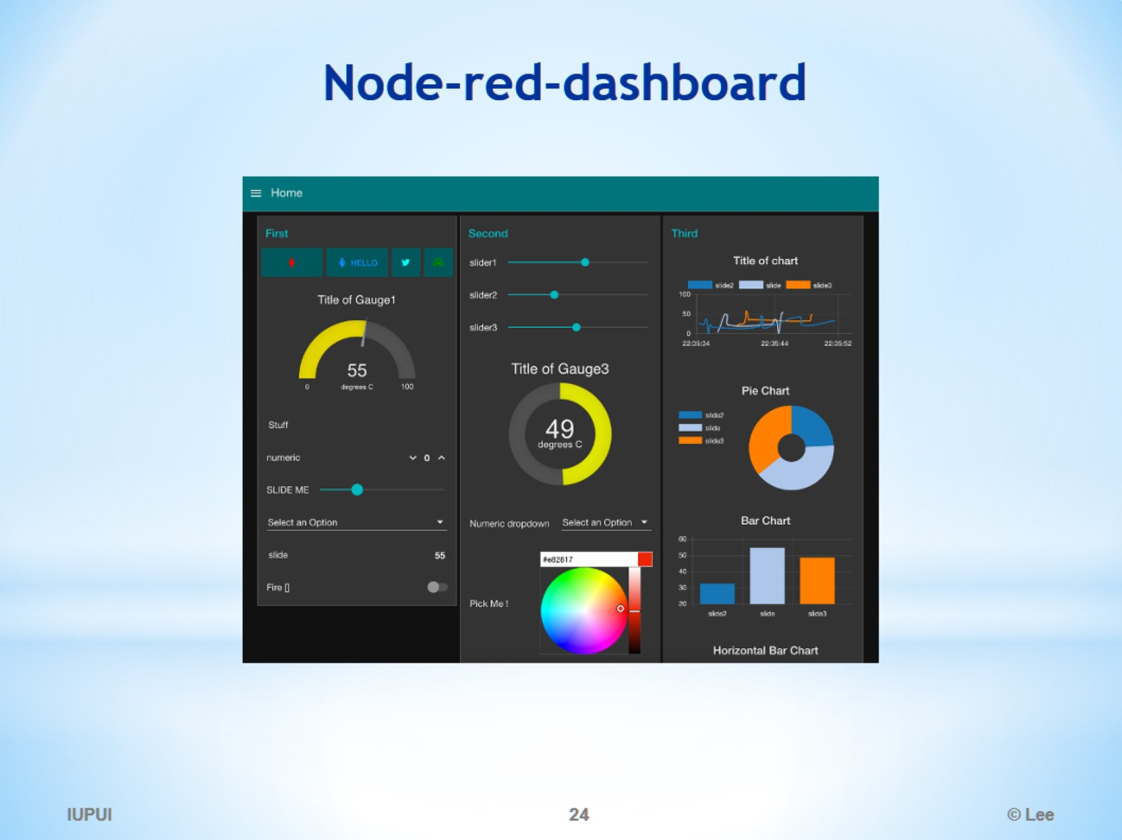
Node-red-dashboard

Slide 25
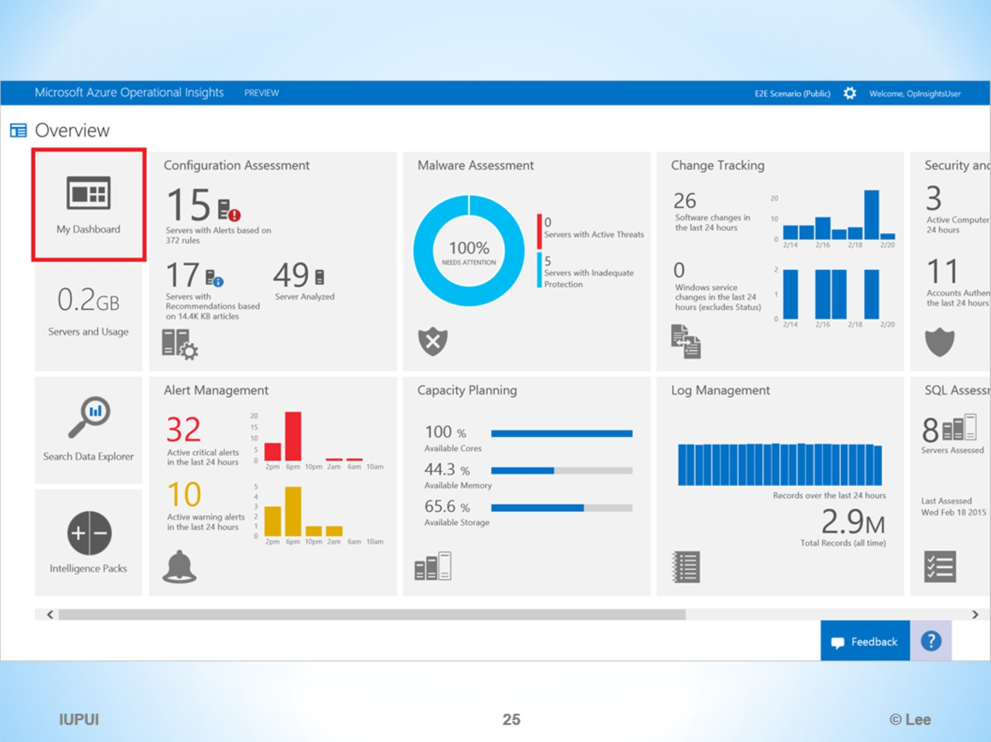

Slide 26
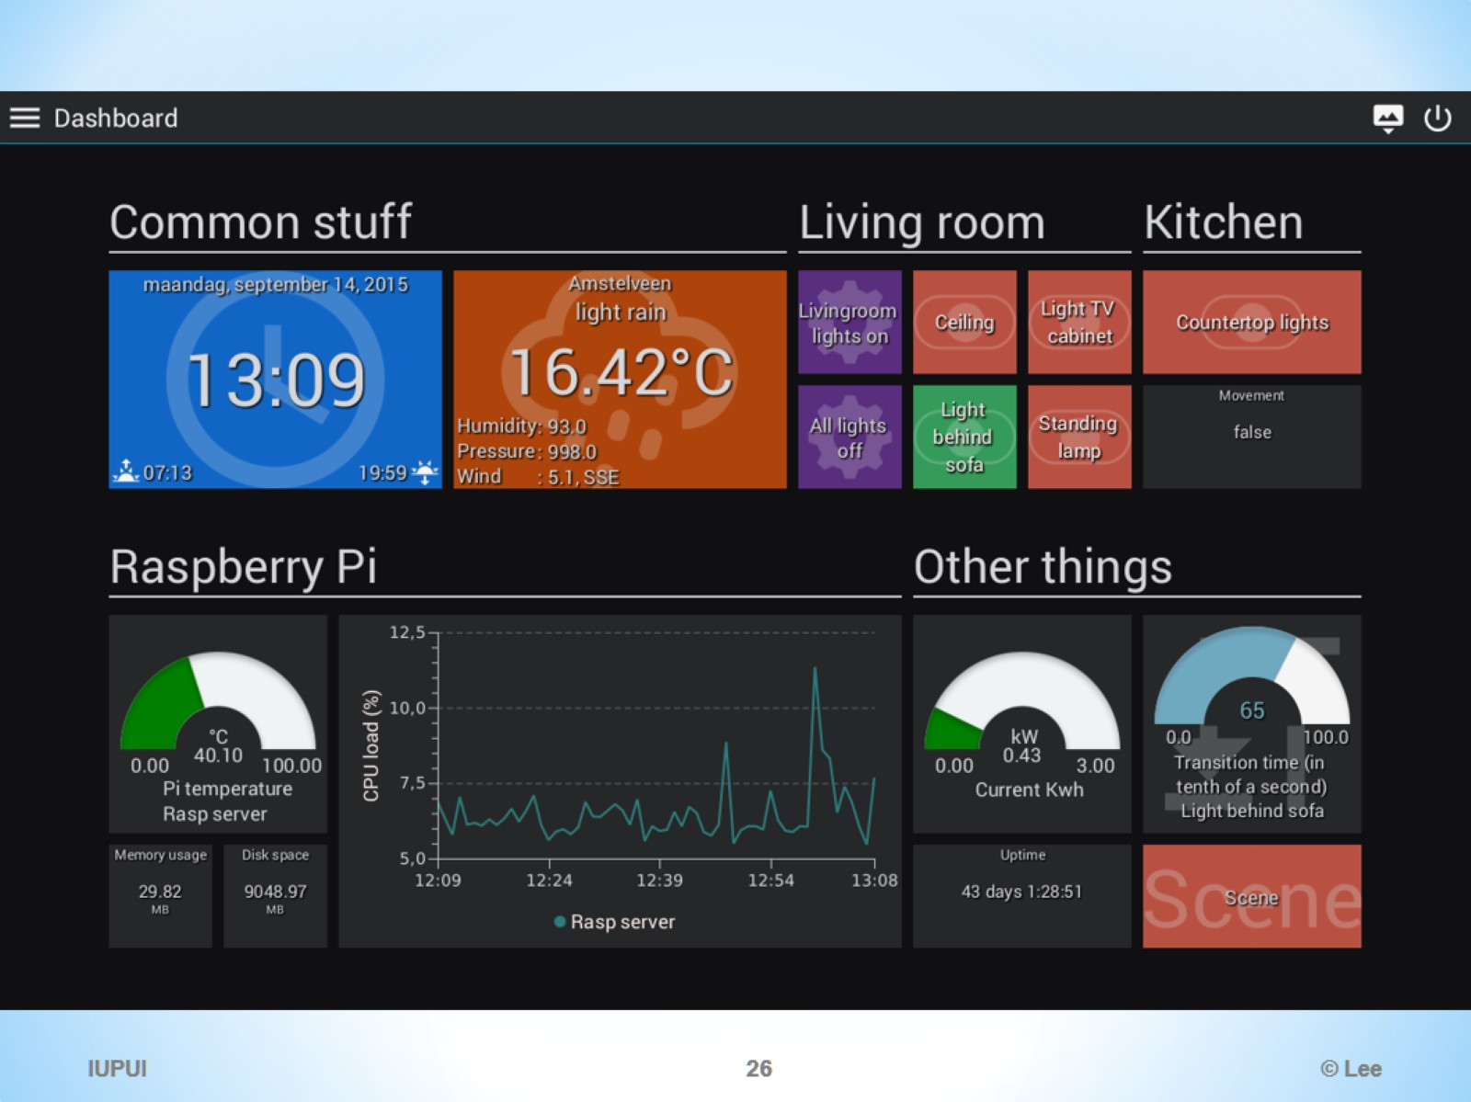

Slide 27
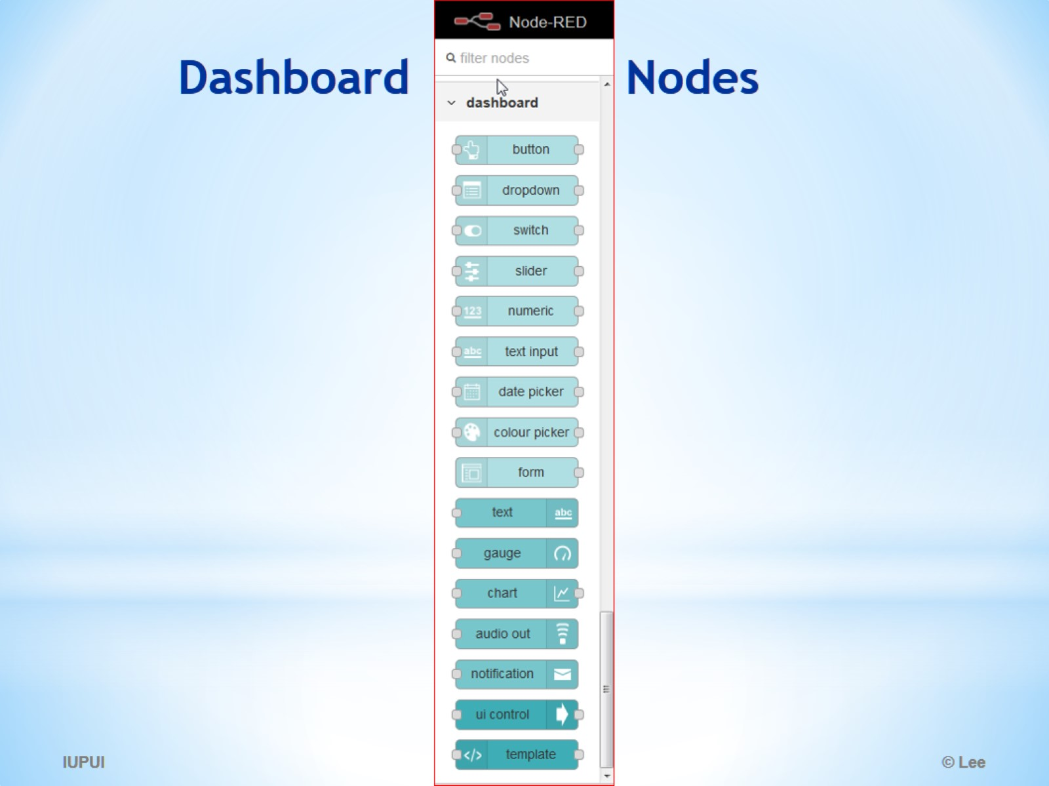
Dashboard Nodes

